Slide 1
See, Think, Wonder
In your books write,
Three things you see,
Two things you think, and
One thing you wonder about this image
Notes:
As a young man, Charles Perkinsregularly took the bus from Sydney Universityto his home in Bondi. This iconic imagewas captured by photojournalist RobertMcFarlane in 1961, when Perkins was justbeginning to gain attention for his activism

Slide 3
Learning Intentions
Success Criteria

Slide 4
Paragraph Structure
Topic sentence (link to question!
What are citizenship rights and how were they an issue for Indigenous rights and freedoms?
How did Indigenous peoples fight for citizenship rights?
To what extend did they succeed?
Link back to question
Remember to include at least one primary source! And integrate it into your writing!

Slide 5
Citizenship Rights
Amendments to the Commonwealth Electoral Act in 1962 allowed Aboriginal and Torres Strait Islander people to vote in Commonwealth elections, however state governments could still exclude them from voting in state elections.
This was because ATSIs were not counted in the census meaning they were not Australian citizens. The Commonwealth could not make laws for them and as a result there was significant inequality between states.
Essentially, ATSI were not granted the rights and freedoms that come with being a citizen of Australia, rights and freedoms that were considered inalienable for white Australians.

Slide 6
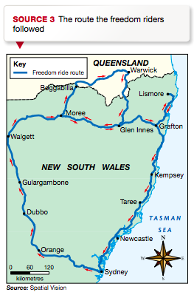
Freedom Rides
Inspired by a similar civil rights action in America, Perkins organised the Freedom Ride of1965, in which a group of 30 white university students from Student Action for Aborigines (SAFA) would take a bus tour of outback New South Wales. The journey was intended to be a ‘study tour’ of race relations in Australia. Over the following two weeks, the group saw the desperate poverty and often unsanitary living conditions experienced by Indigenous people and witnessed the racial discrimination directed against them. In the town of Moree Indigenous children were banned from using the public swimming pool. In Bowraville the cinema was partitioned. And in Walgett Indigenous veterans were allowed into the Returned Soldiers’ League only on Anzac Day.
Notes:
https://www.sbs.com.au/ondemand/video/630887491956/the-freedom-rides

Slide 7
Freedom Rides
Newspaper and television coverage of the Freedom Ride created awareness and discussion in Australia about the racist injustices faced by Australia’s First Peoples. This media attention and debate aided the campaign for removal of discrimination in the Australian Constitution, with the referendum in 1967 being carried. Charles Perkins had emerged as a national leader for Aboriginal Australians, and a role model for prosecuting a cause using non-violent means.

Slide 8
1967 Referendum
In 1967 there remained one area in which Aboriginal and Torres Strait Islander peoples were treated very differently from every other member of the Australian population: they were not counted in the national census. The census is a tool used by the government to count its citizens and extract important demographic information such as their age and gender and where they live. This information can then be used to make appropriate plans for providing community services such as schooling, health care and housing.

Slide 9
1967 Referendum
The Australian Constitution stated, ‘In reckoning the numbers of the people of the Commonwealth, or of a State or other part of the Commonwealth, aboriginal natives shall not be counted.’ To Aboriginal activist Chicka Dixon, the message the Constitution conveyed was quite clear:‘[It] said the Australian Commonwealth Government would recognize all races of people other than Aboriginal — in other words, we didn’t exist …’
The only way to change the Constitution was to hold a referendum. Before 1967 there had been 26 referenda in Australia, only four of which had been carried (approved). For a proposal to succeed, a majority of voters must say ‘yes’; also, the majority ‘yes’ vote must occur in a majority of states (that is, at least four).

Slide 10
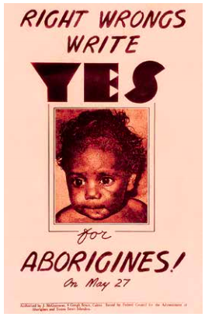
1967 Referendum
The referendum planned for 27 May 1967 would put two proposals to the Australian people:
• that Aboriginal people should be counted in the census
• that Aboriginal people should be placed under the jurisdiction of the Commonwealth, not state governments, so that laws affecting them could be implemented consistently and fairly across Australia.
Before the vote a publicity campaign was organised and all eligible voters were sent a booklet spelling out the ‘yes’ and ‘no’ cases. Both proposals received overwhelming bipartisan support, with a staggering90.7 per cent of votes in favour, the highest ‘yes’ vote ever recorded in a referendum in Australia.

Slide 11
From Assimilation to Integration
After Aboriginal and Torres Strait Islander peoples had gained the rights to vote in federal election sand to be counted in the census, institutional discrimination began to soften. But the shift in policy from ‘assimilation’ to ‘integration’ was due, in large part, to the hundreds of thousands of new migrants who had entered the country since the end of World War II and were trying to find the balance between honouring their traditional beliefs, language and culture, and adopting the Australian way of life. Unlike assimilation, integration policy did not require a person to deny their cultural background, including their language, in order to become a valuable member of society. Yet while integration was a step in the right direction, it fell short of recognising the true value of other cultures. Integration policy, like assimilation before it, still expected citizens to adapt to the needs of the country, rather than the other way around.

Slide 12
Paragraph Structure
Remember to:
Include at least one primary source AND integrate it into your writing.
Keep a record of your resources used.
Consult the rubric as you go.
Topic sentence (link to question!
What are citizenship rights and how were they an issue for Indigenous rights and freedoms?
How did Indigenous peoples fight for citizenship rights?
To what extend did they succeed?
Link back to question

Slide 13
Reflection Breaks
What are you learning, and how are you going with it?
What are you finding easy to learn/remember? Why?
What are you finding hard to learn/remember? Why?

Slide 14
Brain Break
Notes:
Would you rather
Gun thumbs
Find your centre
Desk drumming
Scissors paper rock cheer squad
Name circle
Silent ball

Slide 15
Red Light (what’s going on??)
Write down as many words from today’s lesson as you can remember
Re-order your words from least important to most important
Try linking your most important words to form an explanation of today’s content
Yellow Light (still figuring it out…)
Explain…
Compare and contrast…
Green Light (ready to go!)
Compare and contrast…
Evaluate…
Notes:
12:05

Slide 16
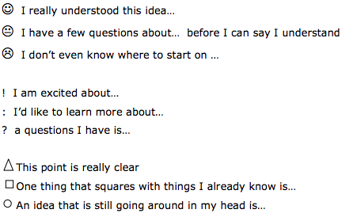
Exit Slips
Letter to an Absent student
KWL
Two stars and a wish
What went well
Summary paragraph
Gallery walk
Snowstorm (facts/questions)
Notes:
https://www.edutopia.org/blog/22-powerful-closure-activities-todd-finley
http://www.stma.k12.mn.us/documents/DW/Q_Comp/40_ways_to_leave_a_lesson.pdf

